Slide 1
GRADE 7 ACCELERATED · UNIT 3 · LESSON 2
Quotient Laws of Exponents
MA.7.NSO.1.1
I can use the quotient of powers, power of a quotient and zero exponent laws to rewrite and evaluate a numerical expression.
Grade 7 Accelerated · Unit 3 · Lesson 2 — Quotient Laws of Exponents
1

Slide 2

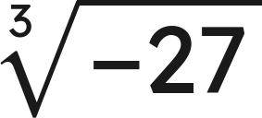

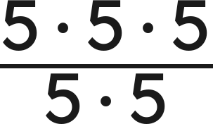
Warm-Up
1. Write as one power:
2.
3. Solve
4. Simplify
Grade 7 Accelerated · Unit 3 · Lesson 2 — Quotient Laws of Exponents
2

Slide 3

Warm-Up
1. Write as one power:
2.
−3
3. Solve
x < 4
4. Simplify
5
Grade 7 Accelerated · Unit 3 · Lesson 2 — Quotient Laws of Exponents
3

Slide 4
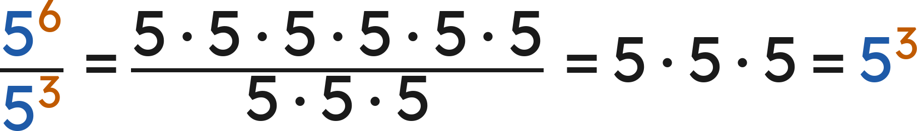
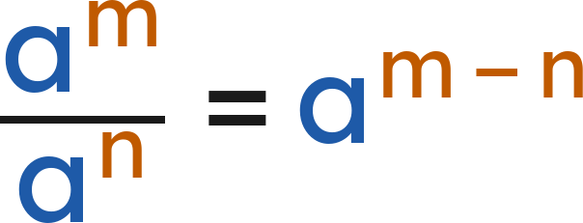

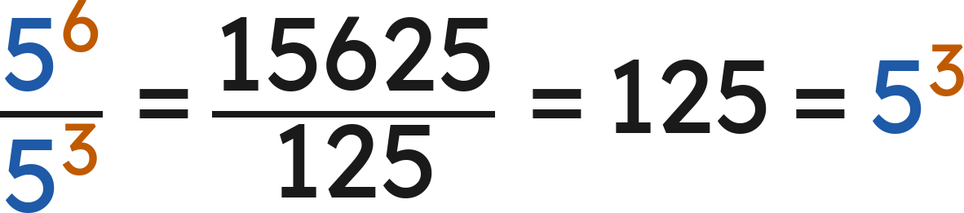
Notes
I. Quotient of powers — same base, subtract the exponents
Quotient of powers:
(
)
Check with values:
Grade 7 Accelerated · Unit 3 · Lesson 2 — Quotient Laws of Exponents
4

Slide 5
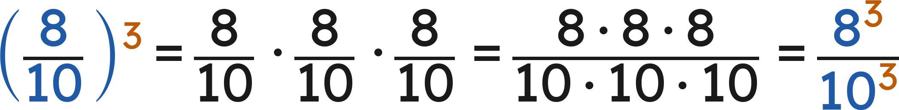
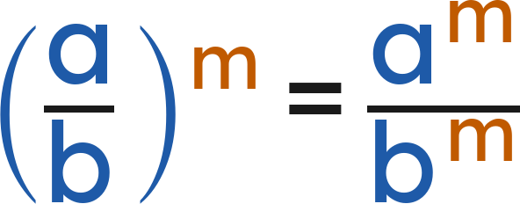

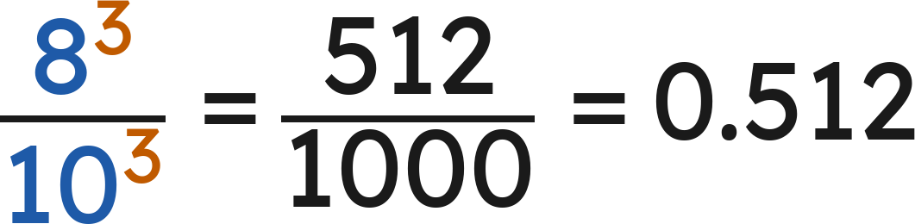
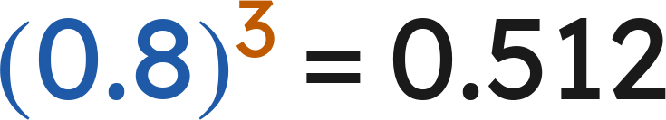
Notes
II. Power of a quotient — the exponent goes top and bottom
Power of a quotient:
(
)
Either way:
and
Grade 7 Accelerated · Unit 3 · Lesson 2 — Quotient Laws of Exponents
5

Slide 6
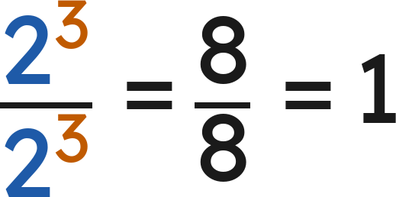
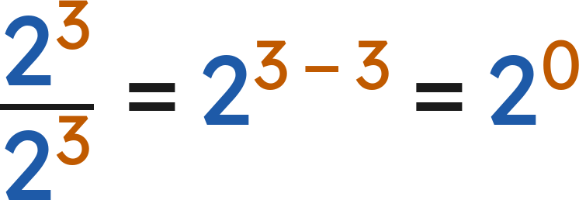

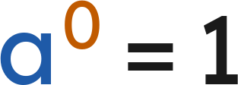

Notes
III. The zero exponent — two roads to the same answer
2⁴ | 2³ | 2² | 2¹ | 2⁰
16 | 8 | 4 | 2 | 1
and
so
Zero exponent:
for every nonzero
Grade 7 Accelerated · Unit 3 · Lesson 2 — Quotient Laws of Exponents
6

Slide 7
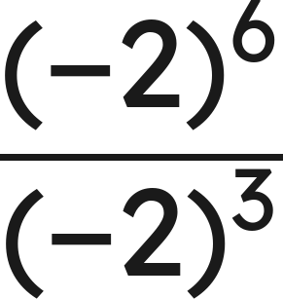
Example 1
Which law? Then find the value.
Grade 7 Accelerated · Unit 3 · Lesson 2 — Quotient Laws of Exponents
7

Slide 8
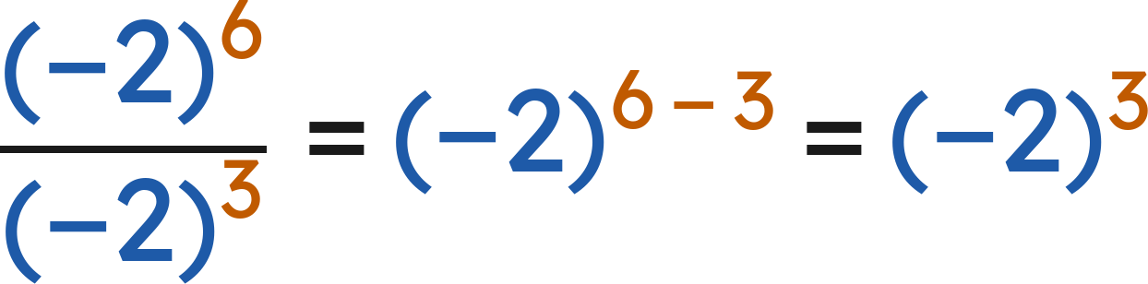
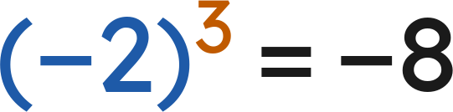
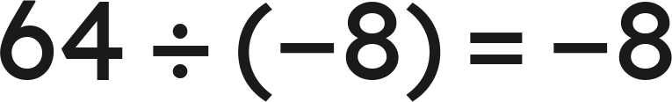
Example 1
Answer: −8
Grade 7 Accelerated · Unit 3 · Lesson 2 — Quotient Laws of Exponents
8

Slide 9

Your Turn
Which law? Then find the value.
Grade 7 Accelerated · Unit 3 · Lesson 2 — Quotient Laws of Exponents
9

Slide 10

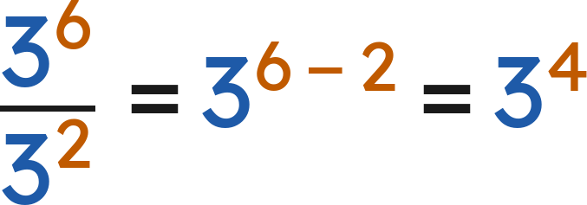

Your Turn
Which law? Then find the value.
Answer: 3⁴ = 81
Grade 7 Accelerated · Unit 3 · Lesson 2 — Quotient Laws of Exponents
10

Slide 11
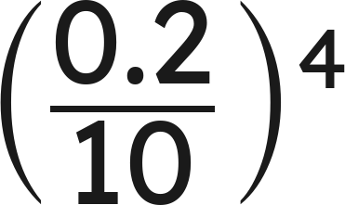
Example 2
Find the value.
Grade 7 Accelerated · Unit 3 · Lesson 2 — Quotient Laws of Exponents
11

Slide 12
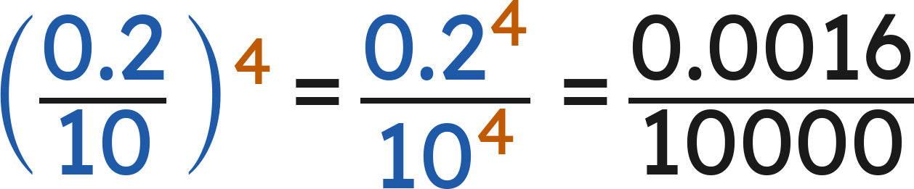
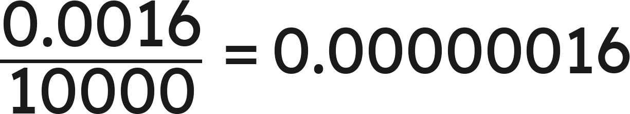
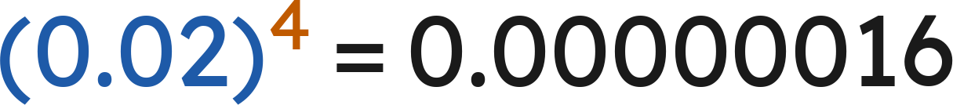
Example 2
Answer: 0.00000016
Grade 7 Accelerated · Unit 3 · Lesson 2 — Quotient Laws of Exponents
12

Slide 13
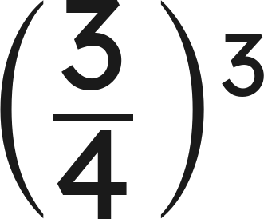
Your Turn
Find the value.
Grade 7 Accelerated · Unit 3 · Lesson 2 — Quotient Laws of Exponents
13

Slide 14
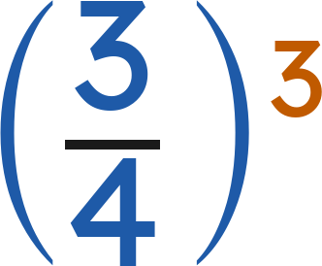
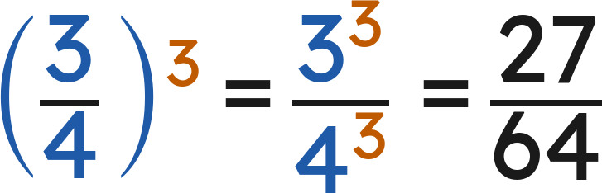
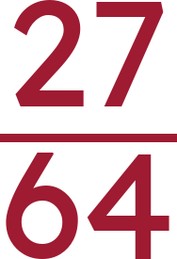
Your Turn
Find the value.
Answer:
Grade 7 Accelerated · Unit 3 · Lesson 2 — Quotient Laws of Exponents
14

Slide 15
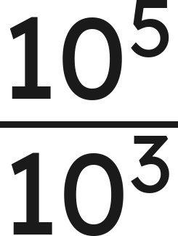
Whiteboards · Question 1 of 9
Answer it.
Grade 7 Accelerated · Unit 3 · Lesson 2 — Quotient Laws of Exponents
15

Slide 16
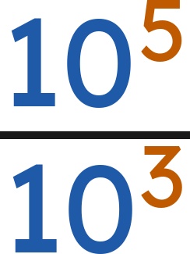
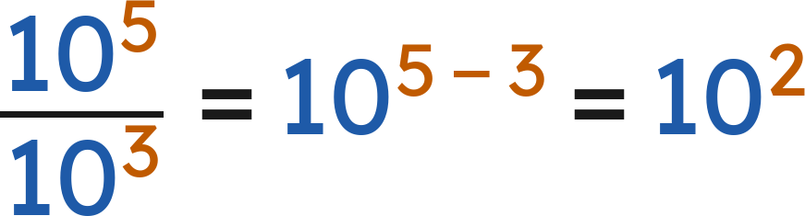

Whiteboards · Question 1 of 9
Answer:
Grade 7 Accelerated · Unit 3 · Lesson 2 — Quotient Laws of Exponents
16

Slide 17

Whiteboards · Question 2 of 9
A website puts
photos into 8 equal albums.
The site is 30 days old.
How many photos are in each album?
Answer it.
Grade 7 Accelerated · Unit 3 · Lesson 2 — Quotient Laws of Exponents
17

Slide 18



Whiteboards · Question 2 of 9
A website puts
photos into 8 equal albums.
The site is 30 days old.
How many photos are in each album?
Answer: 512
Grade 7 Accelerated · Unit 3 · Lesson 2 — Quotient Laws of Exponents
18

Slide 19
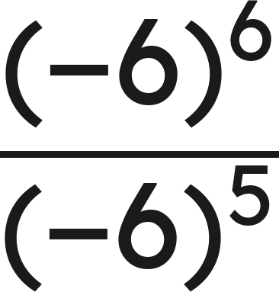
Whiteboards · Question 3 of 9
Answer it.
Grade 7 Accelerated · Unit 3 · Lesson 2 — Quotient Laws of Exponents
19

Slide 20
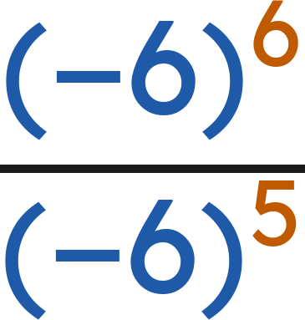
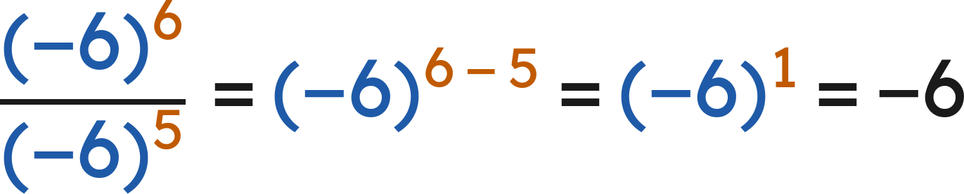
Whiteboards · Question 3 of 9
Answer: −6
Grade 7 Accelerated · Unit 3 · Lesson 2 — Quotient Laws of Exponents
20

Slide 21
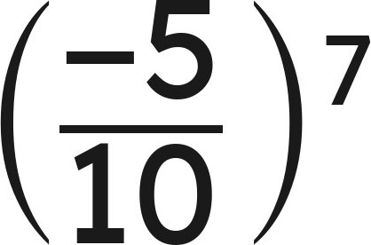
Whiteboards · Question 4 of 9
Answer it.
Grade 7 Accelerated · Unit 3 · Lesson 2 — Quotient Laws of Exponents
21

Slide 22
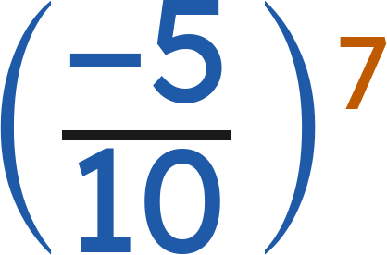
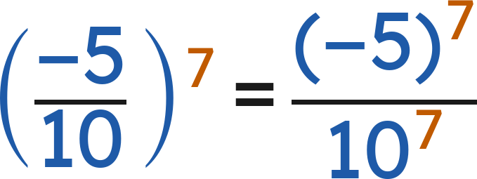
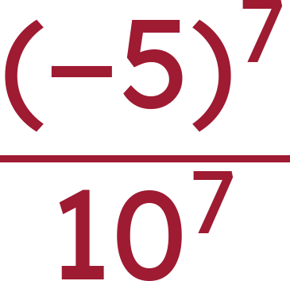
Whiteboards · Question 4 of 9
Answer:
Grade 7 Accelerated · Unit 3 · Lesson 2 — Quotient Laws of Exponents
22

Slide 23

Whiteboards · Question 5 of 9
Which is the value?
A. 1
B. 9
C. 1/9
D. 0
Answer it.
Grade 7 Accelerated · Unit 3 · Lesson 2 — Quotient Laws of Exponents
23

Slide 24


Whiteboards · Question 5 of 9
Which is the value?
Any nonzero number to the power 0 is 1.
Answer: A — 1
Grade 7 Accelerated · Unit 3 · Lesson 2 — Quotient Laws of Exponents
24

Slide 25
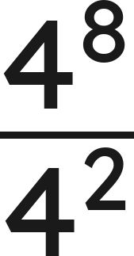
Whiteboards · Question 6 of 9
Which expression is equivalent?
A. 1⁶
B. 4¹⁰
C. 4⁶
D. 4⁴
Answer it.
Grade 7 Accelerated · Unit 3 · Lesson 2 — Quotient Laws of Exponents
25

Slide 26
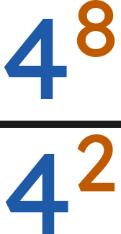
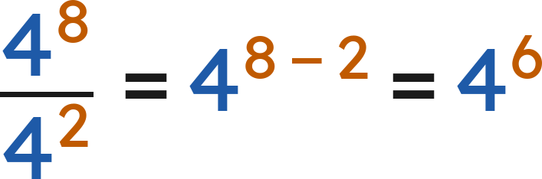
Whiteboards · Question 6 of 9
Which expression is equivalent?
Answer: C — 4⁶
Grade 7 Accelerated · Unit 3 · Lesson 2 — Quotient Laws of Exponents
26

Slide 27
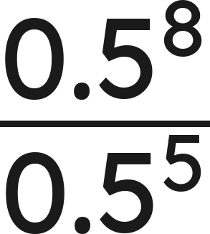
Whiteboards · Question 7 of 9
Answer it.
Grade 7 Accelerated · Unit 3 · Lesson 2 — Quotient Laws of Exponents
27

Slide 28
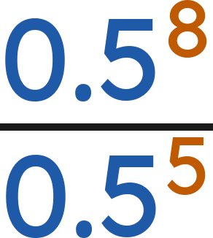
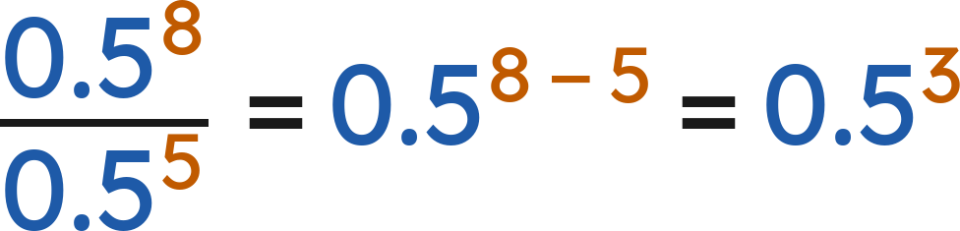
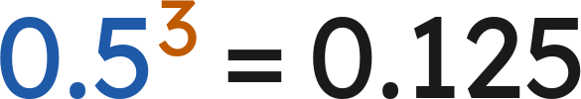
Whiteboards · Question 7 of 9
Answer: 0.125
Grade 7 Accelerated · Unit 3 · Lesson 2 — Quotient Laws of Exponents
28

Slide 29
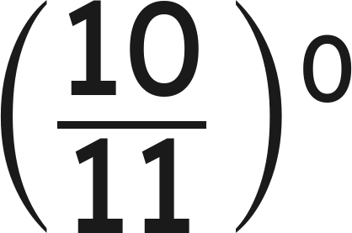
Whiteboards · Question 8 of 9
Answer it.
Grade 7 Accelerated · Unit 3 · Lesson 2 — Quotient Laws of Exponents
29

Slide 30
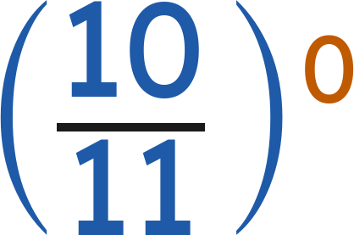
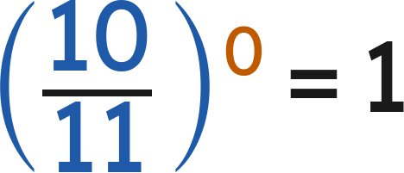
Whiteboards · Question 8 of 9
Any nonzero number to the power 0 is 1.
Answer: 1
Grade 7 Accelerated · Unit 3 · Lesson 2 — Quotient Laws of Exponents
30

Slide 31
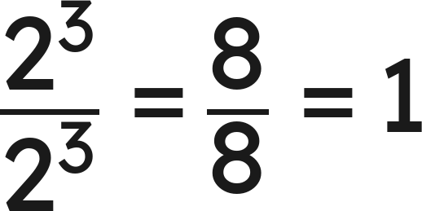
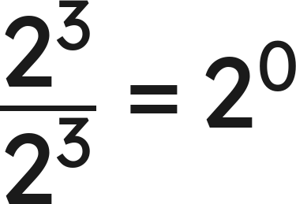
Whiteboards · Question 9 of 9
Hannah cancels:
. Sebastian subtracts:
.
Who is right?
Write your answer in sentences.
Grade 7 Accelerated · Unit 3 · Lesson 2 — Quotient Laws of Exponents
31

Slide 32
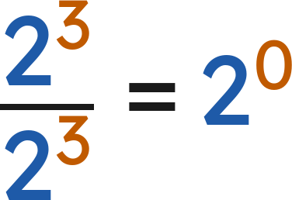
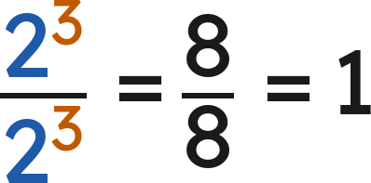
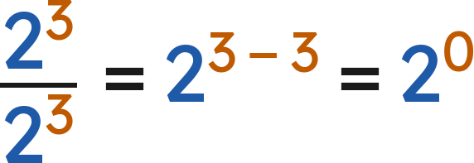

Whiteboards · Question 9 of 9
Hannah cancels:
. Sebastian subtracts:
.
Who is right?
Hannah:
Sebastian:
Same fraction, so
Answer: Both — 2⁰ = 1
Grade 7 Accelerated · Unit 3 · Lesson 2 — Quotient Laws of Exponents
32

Slide 33







Independent Set
1.
Write as one power.
2.
Find the value.
3.
Find the value.
4.
Rewrite so the exponent is on the numerator and on the denominator.
5.
Find the value.
6.
Find the value of
.
Grade 7 Accelerated · Unit 3 · Lesson 2 — Quotient Laws of Exponents
33

Slide 34
IXL
1.
Open IXL and start today's skills.
2.
Work on paper where the question needs work. The answer box does not show it.
3.
Every skill listed is required, to a SmartScore of 67. Due at the start of the next class.
Today's skills — all required
Powers with negative bases — WFW
Division with exponents — XNC
Identify equivalent expressions involving whole-number exponents — KBE
Grade 7 Accelerated · Unit 3 · Lesson 2 — Quotient Laws of Exponents
34

